Slide 1
Team 13 - Image Scrambler Password
Maxwell Warncke, Daniel Rochefort, Doehoon Kim, Richmond Azumah

Slide 2
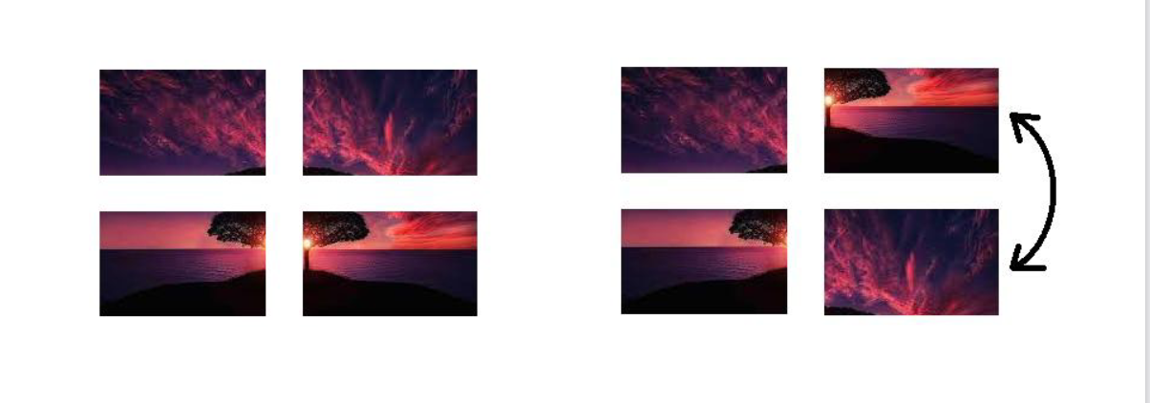
Recap: What is a scrambler password?

Slide 3
Recap: Tech stack
Frontend:
Next.JS
CSS
HTML
Backend:
Next.JS
Firebase Cloud Firestore
Firebase Storage
Notes:
Explain what Next.JS is
Explain how Firebase works

Slide 4
Implementation
Next.JS-based web interface with verification functionality via Firebase
JS image segmentation algorithm- segmenting base image into multiple subimages
Recording position (div indices) of subimages and sending them to backend via Firebase API call
Using recorded positions to verify against scrambled image
Notes:
Explain how images are segmented in Javascript
Explain how the data is stored in Firebase (what is being recorded, what is it’s type, etc)
Explain how the data is being verified on login.

Slide 5
Showcase: Demo and Code

Slide 6
Functional Requirements
Checks if user is an authenticated user
User must enter a valid email format
User is shown image to scramble
Email and selected image sent to database
Image corresponding to user updates for sign in
Notes:
Checks if user is an authenticated user - Checks to see if the current user has previously signed in and not signed out
User must enter a valid email format - Email must be in the format of {string}@{string}.{string}
User is shown an image to scramble - User is given an image to scramble
Email and selected image sent to database - The entered Email and selected image are stored in the database
Image corresponding to user updates for sign in - The image the user selected on sign up is presented to them after entering their email to sign in

Slide 7
Non-Functional Requirements
User interface scales with window size
User login information stored in a secure database
Multiple images displayable
If authentication problem, corresponding error displayed
Image scrambling as swap
Notes:
User interface scales with window size - UI attempts to scale down to keep information in the center of the screen
User login information stored in a secure database - User login information are not stored on an unsecure database
Multiple images displayable - User can scramble an image from a selection of images
If authentication problem, error displayed - If there is an error in log in or sign up, corresponding error message is displayed at the bottom of the screen
Image scrambling as swap - The movement of image tiles swaps them, instead of shifting tiles

Slide 8
Summary of development experience
Project goal
Was it achieved?
Blockers encountered:
Image processing
Storing and interpreting data that needed to be converted
New technologies

Slide 9
Thank you, and have a great winter break!

